Slide 1
Current economic conditions in Minnesota
February 2, 2024
Ron Wirtz
Regional Outreach Director

Slide 2
DISCLAIMER
The views expressed here are the presenter's and not necessarily those of the Federal Reserve Bank of Minneapolis or the Federal Reserve System.

Slide 3
Today’s talk
Current state of the economy
National growth healthy; Minnesota positive, slower
Construction & real estate (esp. residential) hit hard
Still lots (and lots) of challenges
Inflation, interest rates, wages
Labor! Labor! Labor!
Job demand & job growth slower, but steady
Long-term challenges remain
Forecast: Slower, maybe
Interactive survey: Help inform each other on how this group views the economy
Lots of data, but fast-moving; will share PPT

Slide 4
Login for interactive survey
Find out how your peers view current economic conditions!
Immediate, real-time results!
Step 1: Get your phone
Step 2: Send text to 22333
Step 3: Text the word minneapolis
Step 4: Hit ‘send’; watch for message
Step 5: Stay in text mode for survey; all responses to questions are via text
4

Slide 5
First, from 30,000 ft

Slide 6
Gross domestic product
Real GDP = total output, adjusted for inflation
Q4, 2023: 3.3 percent (1st est)
Last four Qs: 3.1% growth
Minnesota seeing same directional trend, but lower
Future GDP getting revised higher and lower (more later)
Source: Bureau of Economic Analysis
6

Slide 7
Sectoral activity
Growth in most sectors, even in some reportedly seeing some slowing (construction)
Source: Census Bureau, Business and Industry database
7

Slide 8
Minnesota sales taxes
Consumer-led recovery doesn’t show many signs of decline
Oct & Nov retail sales taxes 6-8% higher (yoy)

Slide 9
New construction starts
Total value of construction starts, year-to-date through November, compared with 2022:
Residential: -23%
Nonresidential: -2%
Nonbuilding: +11%
Source: Dodge Data & Analytics
Slide 9

Slide 10
Housing permit data – Ninth district
Bigger slide in single-family since peak, some evidence of possible bottom
More dramatic fall-off for multi-family in 2023, evidence of continued slowness
Single-family permits: Ninth District
Year-to-date through November
Slide 10
Source: U.S. Census

Slide 11
Residential Real estate
Single-family home sales slow; feeling for the bottom
Sales “growth” since September, but low bar
Dearth of homes-for-sale putting floor under prices
Source: Minnesota Realtors
11

Slide 12
What are businesses saying?

Slide 13
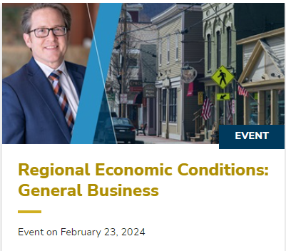
Minneapolis fed surveys
General Business Survey
Still in the field
FREE webinar releasing results
February 23, 9am
Register at: www.minneapolisfed.org

Slide 14
What about among your business contacts?
Survey time!

Slide 15
Notes:
Poll Title: Do not modify the notes in this section to avoid tampering with the Poll Everywhere activity. More info at polleverywhere.com/support RECENT BUSINESS: For this time of year, how would you describe recent revenue trends and general business activity at your company? https://www.polleverywhere.com/multiple_choice_polls/c8nuW9zdZfb4etzjWcbhz

Slide 16
Challenges
What’s your biggest
business challEnge?

Slide 17
Notes:
Poll Title: Do not modify the notes in this section to avoid tampering with the Poll Everywhere activity. More info at polleverywhere.com/support WORD CLOUD: In 1-3 words, what is the biggest challenge for your company? For more than 1 word, use hyphens (I-don't-know); multiple responses OK https://www.polleverywhere.com/free_text_polls/PCkBWogklFaE8Nj6Dt1mg

Slide 18
A deeper look at
inflation
18

Slide 19
Inflation – two measures
Consumer Price Index (CPI)
vs.
Personal Consumption Expenditure (PCE)
Inflation trend improving, but work left to get to Fed’s 2% target
Source: Bureau of Economic Analysis
19

Slide 20
Inflation: Not all goods & services created equal
Inflation for goods: Durables showing continued stubbornness
Inflation for services: Moderate, and stable, but growing
Source: Bureau of Economic Analysis
20

Slide 21
Employment & labor markets
First, Big picture

Slide 22
Total Employment
US job growth holding up surprisingly well
MN also growing, but much flatter; similar to pre-pandemic trend
Why? Stay tuned
Source: Bureau of Labor Statistics
22

Slide 23
Now let’s Peel the onion of employment and labor markets

Slide 24
Notes:
Poll Title: Do not modify the notes in this section to avoid tampering with the Poll Everywhere activity. More info at polleverywhere.com/support LABOR: What BEST describes current hiring demand at your company? https://www.polleverywhere.com/multiple_choice_polls/TgJ91tDDak9FAETpg25Fq

Slide 25
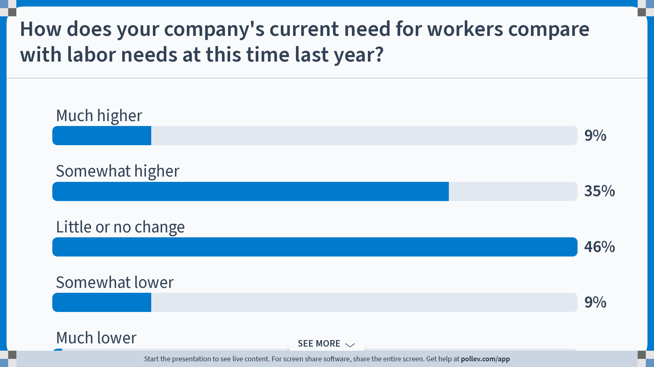
Notes:
Poll Title: Do not modify the notes in this section to avoid tampering with the Poll Everywhere activity. More info at polleverywhere.com/support How does your company's current need for workers compare with labor needs at this time last year? https://www.polleverywhere.com/multiple_choice_polls/OSWE0Ox2ekstS4yltq99k

Slide 26
Hiring demand: still strong
Overall, job openings strong
Notable downtrend in 2022
Plateau in 2023, but comfortably above pre-pandemic levels
Source: Job Openings and Labor Turnover Survey, Bureau of Labor Statistics
26

Slide 27
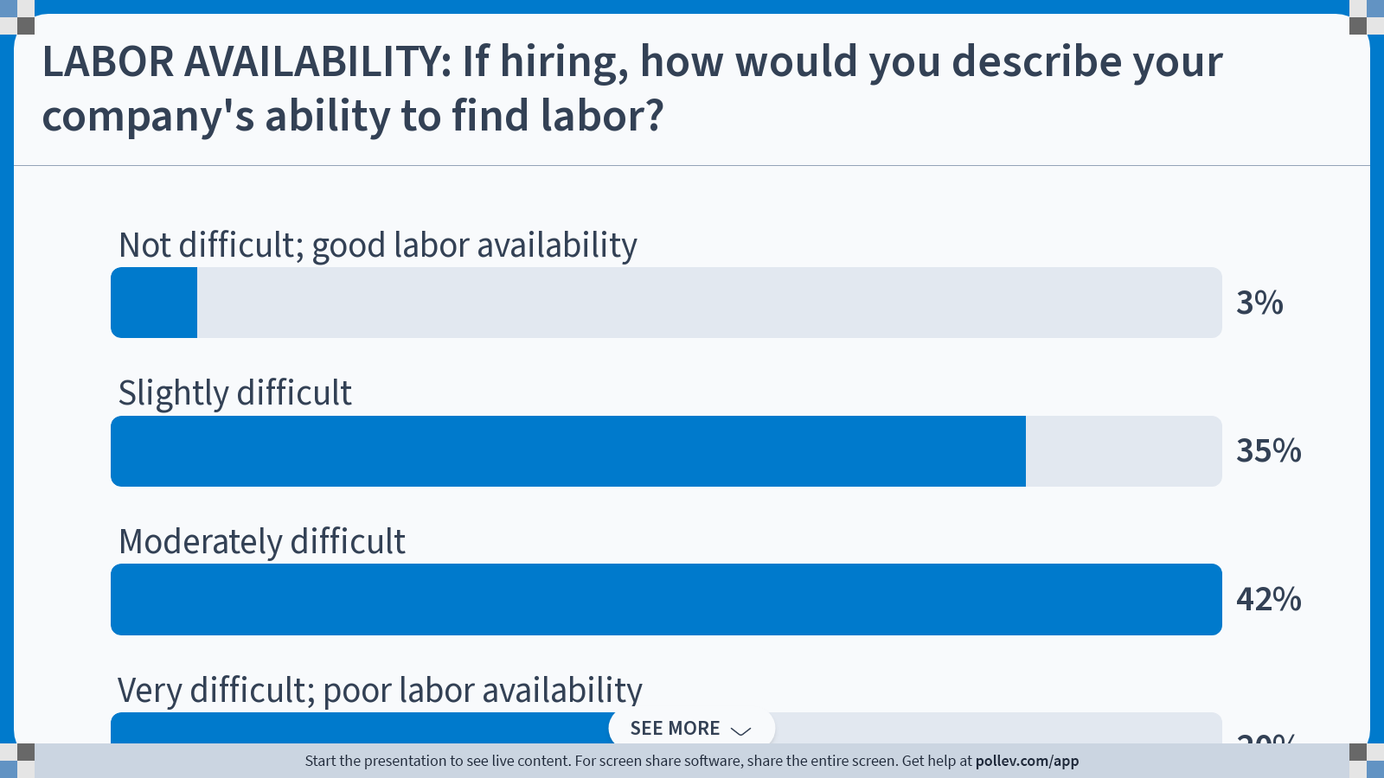
Notes:
Poll Title: Do not modify the notes in this section to avoid tampering with the Poll Everywhere activity. More info at polleverywhere.com/support LABOR AVAILABILITY: If hiring, how would you describe your company's ability to find labor? https://www.polleverywhere.com/multiple_choice_polls/1SX3SkZPcmB0cLwnySyCg

Slide 28
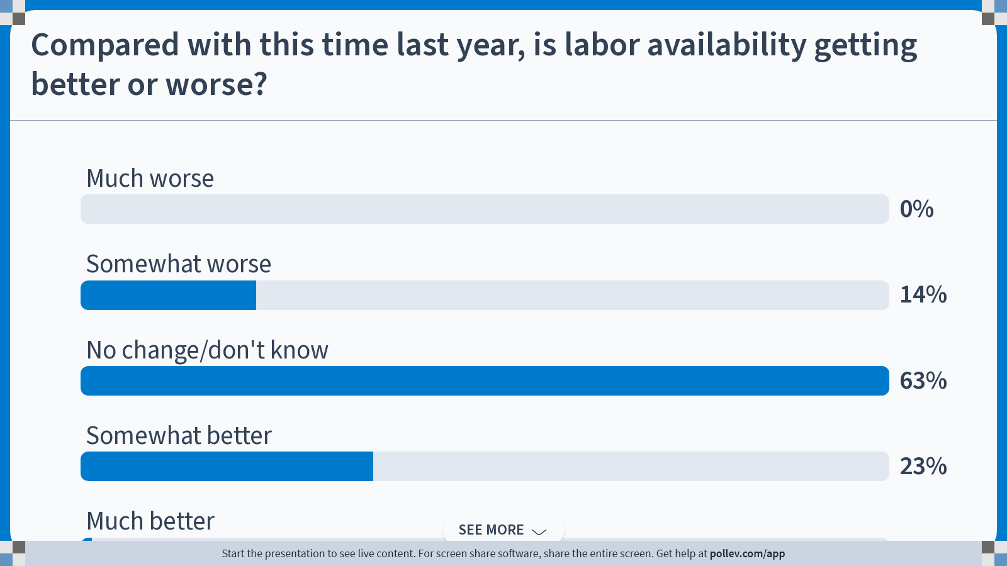
Notes:
Poll Title: Do not modify the notes in this section to avoid tampering with the Poll Everywhere activity. More info at polleverywhere.com/support Compared with this time last year, is labor availability getting better or worse? https://www.polleverywhere.com/multiple_choice_polls/4XWPnrawHU88nEN6ynWtS

Slide 29
minnesota labor markets (all jobs)
Job openings: Hiring demand softened, still strong
Hires: Much flatter
Voluntary quits: Stabilizing, but at higher levels
Layoffs: Generally in check
Overall: Stabilizing, but still lots of job vacancies
= Missed economic growth

Slide 30
why is labor force important to economic growth?

Slide 31
Economic growth 101
Only a few basic ways to grow a business (and by extension, a state or national economy)
Increase productivity

Slide 32
US labor PRODUCTIVITY
For last 2 decades, annual productivity above 2% only during or following recessions & pandemics!
Is productivity burst around the corner?
The last decade+ suggests “no”
Source: Bureau of Labor Statistics

Slide 33
Economic growth 101
Only a few basic ways to grow a business (and by extension, a national economy)
Increase productivity
Increase the number of workers
“Create” more workers
natural increase
migration
Get more people to work, & work more

Slide 34
labor force growth slowing
Labor force: Those 16-and-over employed or unemployed and looking (counted only once regardless of jobs held)
Labor force growth rate has slowed dramatically since 2000
Slowing population growth
Lower labor force participation
.
Source: Bureau of Labor Statistics
34

Slide 35
Population growth
Slow population growth
Minnesota – aver. 30-40k in annual population growth
2020 to 2023: about 20k total
Reason #1: Declining fertility
Reason #2: Lower net migration
35

Slide 36
Components of population change
Average natural increase: Average from 2010-2019 cut in half
Net migration: from positive to negative, and now positive again
36

Slide 37
Components of population change
Average natural increase: Average from 2010-2019 cut in half
Net migration: from positive to negative, and now positive again
International migration: the silver lining
Domestic migration: from slightly negative to deeply negative
37

Slide 38
employment growth, by race
Only (realistic) strategy for Minnesota’s labor force to grow faster than current trend:
Find a way to attract more black and brown workers; domestic & international
FULL. STOP.
Numerical growth
2003 to 2023
Minority workers: 214,000 (> 100%)
White workers: 57,000 (< 3%)
38

Slide 39
A word about immigration
Lots of debate about immigration; border security and immigration policy are related-but-different
Asylum seekers & refugees different than temp work visas
1 million temporary work visas in 2022; almost 300,000 for ag-related fields alone
1.3 million asylum seekers await processing; must wait 6 months (often longer) to apply for work visa; many end up with temp work visas; only 36,000 granted asylum in 2022
Immigration’s impact on US economy = math
Encourage or discourage = related impact on labor
Own whatever side you’re on, and its impact

Slide 40
Labor force participation
First, a quick quiz

Slide 41
Notes:
Poll Title: Do not modify the notes in this section to avoid tampering with the Poll Everywhere activity. More info at polleverywhere.com/support True or false: Nobody wants to work anymore https://www.polleverywhere.com/multiple_choice_polls/o7izszV0wX8tMNSMzeTkj

Slide 42
Labor force participation
The hidden problem: Labor force participation
LFP rates in decline since about 2000
Started to level out … then pandemic hit
MN & (esp.) WI rates not rebounding like US
Much of long-term decline was predictable (aging Boomers); pandemic lag was not
LFPR definition = Share of those over 16, working, or looking for work
Source: Bureau of Labor Statistics
42

Slide 43
Core labor force participation
Prime-age males back to pre-pandemic rates
Prime-age females are way higher than a decade ago
Nobody wants to work anymore?!?
That’s not obvious from the data
Percent

Slide 44
Labor force participation, cont.
It’s not the case that nobody wants to work any more
But older workers want to work less = BIG change

Slide 45
Other factors for affecting labor force growth
Growing entrepreneurship & gig work (we think); makes for more bosses, fewer workers for hire
Unavailable and/or expensive child care
Elephant in the break room: Government asst
“no one wants to work” = whisper-speak for “everyone is on government assistance”
Fact: Enrollment in most govt. asst. programs is flat/down over the last decade
45

Slide 46
Government program enrollments
Majority of public asst programs = LOWER
A word about Medicaid:
60% of expenditures go for poor elderly & disabled
70% of covered able-bodied adults on Medicaid work full-time
Most work at small firms & industries that do not offer health care
Many families face loss of healthcare by working, or working/earning more
Source: Minnesota Dept. of Human Services; Social Security Administration, Department of Labor, US Department of Agriculture

Slide 47
So what’s your point, ron?
Myriad reasons why labor supply is constrained
Fundamentally there’s not enough people growth
Never had to reach this far down into the labor barrel
From that base, can we:
Attract more workers?
Convince more people already here to work (more)?
Framing: Is this an obstacle or an opportunity?
How do we problem-solve for everyone’s benefit?
Investment likely most productive route
Employers and workers already adjusting, but can we accelerate? What role government policy?

Slide 48
Before we go: outlook
Last survey question
(I promise!)
48

Slide 49
Notes:
Poll Title: Do not modify the notes in this section to avoid tampering with the Poll Everywhere activity. More info at polleverywhere.com/support OUTLOOK: What is your outlook for the next 6 months? https://www.polleverywhere.com/multiple_choice_polls/YIzYtlrRTIIt8jXE67Yy1

Slide 50
PRIvate GDP forecasts: Blue Chip
Forecasts one year apart
Private forecasts consistently wrong
Q3 forecast consensus in October was 3.5%; it turned out to be 4.9%
Subsequent forecasts for Q4 ’23 and 2024 expect some slowing
Chart hides a lot of variation among forecasts
Source: Blue Chip Financial Forecasts®, CCH Incorporated
50

Slide 51
Future Gdp: private forecasters
Direction tends to be agreed on, but the degree of change sees wide variation
51
Source: Blue Chip Financial Forecasts®, CCH Incorporated

Slide 52
Interest rate forecast
Solid line = current/Jan. 2024 forecast
Dotted line = January 2023 forecast
Most credit vehicles expected to remain higher for longer
Source: Blue Chip Financial Forecasts®, CCH Incorporated
52

Slide 53
Despite large GDP revisions, path of long-term inflation expectations by middle of 2024 mostly unchanged
General agreement that overall inflation headed back to Fed’s 2% target
Source: Blue Chip Financial Forecasts®, CCH Incorporated
53

Slide 54
Thank you! Questions?
Speech/webinar referrals welcome!
Twitter: @RonWirtz
@MinneapolisFed
Connect via LinkedIn
Ron.wirtz@mpls.frb.org

